Slide 1
RISC and CISC
Reduced Instruction Set Architecture (RISC) – The main idea behind this is to make hardware simpler by using an instruction set composed of a few basic steps for loading, evaluating, and storing operations just like a load command will load data, a store command will store the data.
Complex Instruction Set Architecture (CISC) – The main idea is that a single instruction will do all loading, evaluating, and storing operations just like a multiplication command will do stuff like loading data, evaluating, and storing it, hence it’s complex.
Both approaches try to increase the CPU performance
RISC: Reduce the cycles per instruction at the cost of the number of instructions per program.
CISC: The CISC approach attempts to minimize the number of instructions per program but at the cost of an increase in the number of cycles per instruction.
Characteristic of RISC –
Simpler instruction, hence simple instruction decoding.
Instruction comes undersize of one word.
Instruction takes a single clock cycle to get executed.
More general-purpose registers.
Simple Addressing Modes.
Fewer Data types.
A pipeline can be achieved.
Characteristic of CISC –
Complex instruction, hence complex instruction decoding.
Instructions are larger than one-word size.
Instruction may take more than a single clock cycle to get executed.
Less number of general-purpose registers as operations get performed in memory itself.
Complex Addressing Modes.
More Data types.

Slide 2
RISC | CISC
Focus on software | Focus on hardware
Uses only Hardwired control unit | Uses both hardwired and microprogrammed control unit
Transistors are used for more registers | Transistors are used for storing complex Instructions
Fixed sized instructions | Variable sized instructions
Can perform only Register to Register Arithmetic operations | Can perform REG to REG or REG to MEM or MEM to MEM
Requires more number of registers | Requires less number of registers
Code size is large | Code size is small
An instruction executed in a single clock cycle | Instruction takes more than one clock cycle
An instruction fit in one word | Instructions are larger than the size of one word

Slide 3
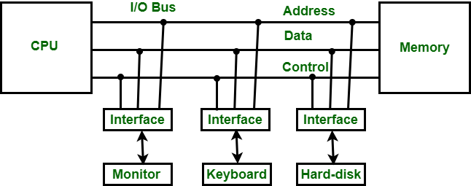
Input-Output Interface
Input-Output Interface is used as an method which helps in transferring of information between the internal storage devices i.e. memory and the external peripheral device . A peripheral device is that which provide input and output for the computer, it is also called Input-Output devices. For Example: A keyboard and mouse provide Input to the computer are called input devices while a monitor and printer that provide output to the computer are called output devices. Just like the external hard-drives, there is also availability of some peripheral devices which are able to provide both input and output.
In micro-computer base system, the only purpose of peripheral devices is just to provide special communication links for the interfacing them with the CPU. To resolve the differences between peripheral devices and CPU, there is a special need for communication links.
The major differences are as follows:
The nature of peripheral devices is electromagnetic and electro-mechanical. The nature of the CPU is electronic. There is a lot of difference in the mode of operation of both peripheral devices and CPU.
There is also a synchronization mechanism because the data transfer rate of peripheral devices are slow than CPU.
In peripheral devices, data code and formats are differ from the format in the CPU and memory.
The operating mode of peripheral devices are different and each may be controlled so as not to disturb the operation of other peripheral devices connected to CPU.

Slide 4
Input/Output versus Memory Bus
In addition to communicate with I/O, the processor must also communicate with memory unit.
And there are three ways that computer buses can be used to communicate with memory as well as I/O.These are:
Use two separate buses one for Memory and other for Input/output(This method is named as IOP method).
Use one common bus for both Memory and I/O but have separate control lines for each(This method is named as Isolated I/O method).
Use one common bus for Memory and I/O with common control lines(This method is named as Memory-Mapped Input/Output method).

Slide 5
1. IOP(Input-Output Processor) method:
In this method the computer has independent sets of data, address and control buses, one for accessing memory(Known as Memory bus and other for I/O known as I/O bus)
Means, to handle communication, in this method, IOP method is used.It provides separate Input- Output Processor(IOP) in addition to Central Processing Unit, and relieves CPU from the task of I/O transfer. That is, CPU communicate to memory via memory bus, and IOP communicates to Input Output devices through separate bus known as I/O bus. And memory communicates with both CPU and IOP through memory bus. Thus, this method provide independent pathways for transfer of information between external devices(I/O devices) and internal memory. 2. Isolated I/O Method:
In this method, to make processor to communicate with CPU and I/O, common bus is used for both memory and I/O and distinction between a memory transfer and I/O transfer is made through separate read and write lines. Means, "I/O Read" and "I/O Write" control lines are enabled during and I/O transfer. And "Memory Read" and "Memory Write" control lines are enabled during a memory transfer. This configuration isolates all I/O interface addresses from the addresses assigned to memory and that’s why this method is known as isolated I/O method for assigning address in a common bus. 3. Memory-Mapped I/O:
In this method, one common bus is used for Memory and I/O with no distinction, and then this configuration is said to be as Memory-Mapped I/O. Because, there are only memory instruction, there is no specific input or output instruction.
And to access or manipulate I/O data, it use some memory instruction that are used to manipulate memory words. That is it allows computers to use the same instructions for either Input/output transfer or for memory transfer. The advantage of it is that the load and store instructions are used for reading and writing from memory can also be used to input and output data.

Slide 6
Asynchronous Data Transfer
The internal operations in an individual unit of a digital system are synchronized using clock pulse. It means clock pulse is given to all registers within a unit. And all data transfer among internal registers occurs simultaneously during the occurrence of the clock pulse. Now, suppose any two units of a digital system are designed independently, such as CPU and I/O interface.
If the registers in the I/O interface share a common clock with CPU registers, then transfer between the two units is said to be synchronous. But in most cases, the internal timing in each unit is independent of each other, so each uses its private clock for its internal registers. In this case, the two units are said to be asynchronous to each other, and if data transfer occurs between them, this data transfer is called Asynchronous Data Transfer.
But, the Asynchronous Data Transfer between two independent units requires that control signals be transmitted between the communicating units so that the time can be indicated at which they send data. These two methods can achieve this asynchronous way of data transfer:
Strobe control: A strobe pulse is supplied by one unit to indicate to the other unit when the transfer has to occur.
Handshaking: This method is commonly used to accompany each data item being transferred with a control signal that indicates data in the bus. The unit receiving the data item responds with another signal to acknowledge receipt of the data.
The strobe pulse and handshaking method of asynchronous data transfer is not restricted to I/O transfer. They are used extensively on numerous occasions requiring the transfer of data between two independent units. So, here we consider the transmitting unit as a source and receiving unit as a destination.

Slide 7
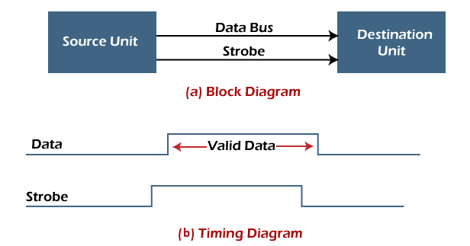

Asynchronous Data Transfer Methods
The asynchronous data transfer between two independent units requires that control signals be transmitted between the communicating units to indicate when they send the data. Thus, the two methods can achieve the asynchronous way of data transfer.
1. Strobe Control Method
The Strobe Control method of asynchronous data transfer employs a single control line to time each transfer. This control line is also known as a strobe, and it may be achieved either by source or destination, depending on which initiate the transfer.
Source initiated strobe: In the below block diagram, you can see that strobe is initiated by source, and as shown in the timing diagram, the source unit first places the data on the data bus.
After a brief delay to ensure that the data resolve to a stable value, the source activates a strobe pulse. The information on the data bus and strobe control signal remains in the active state for a sufficient time to allow the destination unit to receive the data. The destination unit uses a falling edge of strobe control to transfer the contents of a data bus to one of its internal registers. The source removes the data from the data bus after it disables its strobe pulse. Thus, new valid data will be available only after the strobe is enabled again. In this case, the strobe may be a memory-write control signal from the CPU to a memory unit. The CPU places the word on the data bus and informs the memory unit, which is the destination.
Destination initiated strobe: In the below block diagram, you see that the strobe initiated by destination, and in the timing diagram, the destination unit first activates the strobe pulse, informing the source to provide the data.
The source unit responds by placing the requested binary information on the data bus. The data must be valid and remain on the bus long enough for the destination unit to accept it. The falling edge of the strobe pulse can use again to trigger a destination register. The destination unit then disables the strobe. Finally, and source removes the data from the data bus after a determined time interval. In this case, the strobe may be a memory read control from the CPU to a memory unit. The CPU initiates the read operation to inform the memory, which is a source unit, to place the selected word into the data bus.

Slide 8
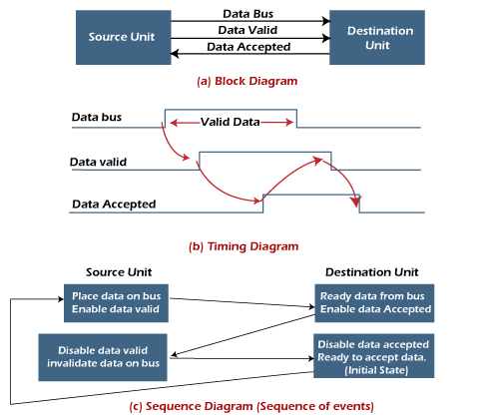
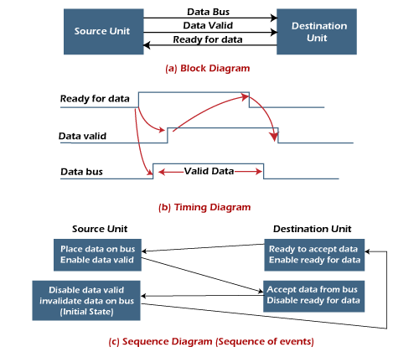
2. Handshaking Method
The strobe method has the disadvantage that the source unit that initiates the transfer has no way of knowing whether the destination has received the data that was placed in the bus. Similarly, a destination unit that initiates the transfer has no way of knowing whether the source unit has placed data on the bus.
So this problem is solved by the handshaking method. The handshaking method introduces a second control signal line that replays the unit that initiates the transfer.
In this method, one control line is in the same direction as the data flow in the bus from the source to the destination. The source unit uses it to inform the destination unit whether there are valid data in the bus.
The other control line is in the other direction from the destination to the source. This is because the destination unit uses it to inform the source whether it can accept data. And in it also, the sequence of control depends on the unit that initiates the transfer. So it means the sequence of control depends on whether the transfer is initiated by source and destination.
Source initiated handshaking: In the below block diagram, you can see that two handshaking lines are "data valid", which is generated by the source unit, and "data accepted", generated by the destination unit.
The timing diagram shows the timing relationship of the exchange of signals between the two units. The source initiates a transfer by placing data on the bus and enabling its data valid signal. The destination unit then activates the data accepted signal after it accepts the data from the bus. The source unit then disables its valid data signal, which invalidates the data on the bus. After this, the destination unit disables its data accepted signal, and the system goes into its initial state. The source unit does not send the next data item until after the destination unit shows readiness to accept new data by disabling the data accepted signal. This sequence of events described in its sequence diagram, which shows the above sequence in which the system is present at any given time.
Destination initiated handshaking: In the below block diagram, you see that the two handshaking lines are "data valid", generated by the source unit, and "ready for data" generated by the destination unit. Note that the name of signal data accepted generated by the destination unit has been changed to ready for data to reflect its new meaning.
The destination transfer is initiated, so the source unit does not place data on the data bus until it receives a ready data signal from the destination unit. After that, the handshaking process is the same as that of the source initiated. The sequence of events is shown in its sequence diagram, and the timing relationship between signals is shown in its timing diagram. Therefore, the sequence of events in both cases would be identical.

Slide 9
Mode of Transfer
The binary information that is received from an external device is usually stored in the memory unit. The information that is transferred from the CPU to the external device is originated from the memory unit. CPU merely processes the information but the source and target is always the memory unit. Data transfer between CPU and the I/O devices may be done in different modes.
Data transfer to and from the peripherals may be done in any of the three possible ways
Programmed I/O.
Interrupt- initiated I/O.
Direct memory access( DMA).
Programmed I/O: It is due to the result of the I/O instructions that are written in the computer program. Each data item transfer is initiated by an instruction in the program. Usually the transfer is from a CPU register and memory. In this case it requires constant monitoring by the CPU of the peripheral devices.
Interrupt- initiated I/O: Since in the above case we saw the CPU is kept busy unnecessarily. This situation can very well be avoided by using an interrupt driven method for data transfer. By using interrupt facility and special commands to inform the interface to issue an interrupt request signal whenever data is available from any device. In the meantime the CPU can proceed for any other program execution. The interface meanwhile keeps monitoring the device. Whenever it is determined that the device is ready for data transfer it initiates an interrupt request signal to the computer. Upon detection of an external interrupt signal the CPU stops momentarily the task that it was already performing, branches to the service program to process the I/O transfer, and then return to the task it was originally performing.
Direct Memory Access: The data transfer between a fast storage media such as magnetic disk and memory unit is limited by the speed of the CPU. Thus we can allow the peripherals directly communicate with each other using the memory buses, removing the intervention of the CPU. This type of data transfer technique is known as DMA or direct memory access. During DMA the CPU is idle and it has no control over the memory buses. The DMA controller takes over the buses to manage the transfer directly between the I/O devices and the memory unit.

Slide 10
Interrupts
The interrupt is a signal emitted by hardware or software when a process or an event needs immediate attention. It alerts the processor to a high-priority process requiring interruption of the current working process. In I/O devices one of the bus control lines is dedicated for this purpose and is called the Interrupt Service Routine (ISR).
When a device raises an interrupt at let’s say process i, the processor first completes the execution of instruction i. Then it loads the Program Counter (PC) with the address of the first instruction of the ISR. Before loading the Program Counter with the address, the address of the interrupted instruction is moved to a temporary location. Therefore, after handling the interrupt the processor can continue with process i+1.
While the processor is handling the interrupts, it must inform the device that its request has been recognized so that it stops sending the interrupt request signal. Also, saving the registers so that the interrupted process can be restored in the future, increases the delay between the time an interrupt is received and the start of the execution of the ISR. This is called Interrupt Latency.
Interrupt and its types
Different types of program interrupt are:-
Hardware interrupt
Software interrupt

Slide 11
Hardware interrupt
Interrupt generated by the hardware of the computer system is called hardware interrupts. For example: In the continuation of a running program, if we press any key from the keyboard, then a signal is generated to the processor, which is called an interrupt and is first executed by the system.
Hardware interrupts are classified into two categories.
External and Internal interrupts – Both are initiated from the signal that occurs in the CPU hardware.
External interrupt - These interrupts are generated by hardware internally. These are asynchronous (does not depend on anything) and predictable interrupts. Example of external interrupts are:-
Timings of input/output devices when they request for data transfer.
Power failure due to circuit monitoring the power supply or any external source creates an interrupt.
A program that goes into an endless loop generates a timeout interrupt.
When the input/output device finished the transfer of data.
Internal interrupt – These interrupts are generated when there is an "error in instruction” happens. This type of interrupts results from illegal and erroneous use of instruction, widely known as “Traps”. Internal interrupts are “synchronous”( depend on the timer clock) with the program. These are unpredictable interrupts.
Reasons for internal interrupts are:-
It happens due to register overflow error occur.
When divide by zero, errors occur.
Due to an invalid operation code ( Opcode).

Slide 12
Software interrupts
It is a special type of instruction that behaves like an interrupt created by the user rather than a subroutine call. It is an error generating program created by the user whenever the user wants to create, widely known as a software interrupt. It is initiated by executing an instruction or an interrupt procedure at any desired point of the program.
For example, Some error instructions are generated to check the proper functioning of the program.
Supervisor call instruction generates a software interrupt to switch from user mode to supervisor mode.
There are two cases of occurrence of software interrupts.
Normal interrupt- When an interrupt created by instruction or user made an error program intentionally are normal software interrupts.
Exceptional interrupt- An exception case of interrupt or unplanned instruction generated in a program like a number is generated during the execution of an instruction divisible by zero will give undefined value and creates an interrupt.

